Slide 1



Micro project Terminating a process using a kill command by just entering pid
Done by:- (59)Jayprakash S. Nair , (60)Jees maria joy
(57)Ihsan shihab , (58)Jayanth B . r.

Slide 2
Project intro
We used PyQt5 to develop the text input field so that we could enter the pid.
After we did the coding in python .
The program first lists all the processes running in the system and after that it asks the user to enter the pid.
Now a search is done till the matching pid is found.
And the process is deleted using the kill command.

Slide 3
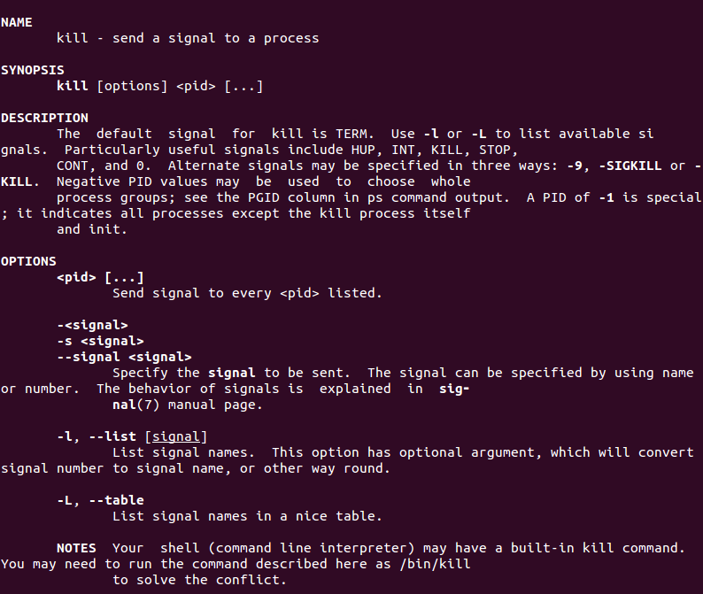
Kill command as in manual
The code for getting this page is
man kill

Slide 4
Kill command in easy words
The kill command is usually used to kill a process. Internally it sends a signal, and depending on what you want to do, there are different signals that you can send using this tool. Following is the command's syntax:
kill [options] <pid> [...]
And here's how the tool's man page describes it:
The default signal for kill is TERM. Use -l or -L to list available signals. Particularly useful signals include HUP, INT, KILL, STOP, CONT, and 0. Alternate signals may be specified in three ways: -9, -SIGKILL or -KILL. Negative PID values may be used to choose whole process groups; see the PGID column in ps command output. A PID of -1 is special; it indicates all processes except the kill process itself and init.

Slide 5
About our project
What our Project do:-
Diplay and text input field where pocess id can be given as input and kills the process with the given process id. (Hint: kill command)
Thus this allows the user to delete a certain process by just entering the process id.

Slide 6
PROGRAM CODE:
import PyQt5
import psutil
import sys
import os
from PyQt5.QtWidgets import QApplication, QWidget, QInputDialog, QLineEdit
from PyQt5.QtGui import QIcon
for proc in psutil.process_iter():
try:
# Get process name & pid from process object.
processName = proc.name()
pid = proc.pid
print(processName , ' ::: ', pid)
except (psutil.NoSuchProcess, psutil.AccessDenied, psutil.ZombieProcess):
pass

Slide 7
class App(QWidget):
def __init__(self):
super().__init__()
self.title = 'PyQt5 input dialogs '
self.left = 10
self.top = 10
self.width = 640
self.height = 480
self.initUI()
def initUI(self):
self.setWindowTitle(self.title)
self.setGeometry(self.left, self.top, self.width, self.height)
self.getInteger()
def getInteger(self):
i, okPressed = QInputDialog.getInt(self, "Get integer","PID:", 0, 0,99999 , 1)
if okPressed:
p = psutil.Process(i)
p.kill()
exit()

Slide 8
if __name__ == '__main__':
app = QApplication(sys.argv)
ex = App()
sys.exit(app.exec_())

Slide 9
Benefits
The main benefit of the program is that we could easily delete a certain process by just entering the pid.
This program code thus helps in reduces the time taken by the user to delete a task and make the process faster.
It is user friendly

Slide 10



